Slide 1
Automatic Night Lamp With Alarm
Members:
A .Joey Infant Rex – 2019504531
R .Abhinav – 2019504502
H .Denicke Solomon - 2019504513
Contents:
Objectives
Materials Required
Circuit Diagram
Product Description & Applications

Slide 2

Objectives:
To design an Automatic Night Lamp with Morning Alarm , act as Light Source when the Bedroom lights are switched off & also helps you to study (or) do any work with light without electricity…

Slide 3
Materials Required:
Resistors – (1K - 2, 120K - 1, 220- 1, 550 - 1)
Preset - 47K - 2
Capacitors - 2
PN Junction Diode – IN4007 - 1
Zener Diode – 3.3V - 1
IC- (7806 REG IC – 1, NE555 - 1 , UM66 - 1) & 8 Pin Base
Transistor – BC548 - 2
LDR - 10K - 2, LED – 1
Switch – 3 leg slider – 1
Speaker - 1
9V Battery and Snap
JE074 – PCB - 1

Slide 4
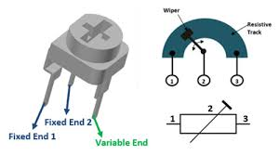

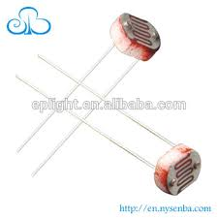
Preset – 47K – PR1, PR2 :
A trim pot (or) trimmer potentiometer is a small
potentiometer which is used for adjustment , tuning and calibration in circuits.
When they are used as a variable resistor.
LDR – Light Dependent resistor – LDR1 , LDR2:
Features:
It has no polarity.
Can be used to sense light.
small, cheap & easily available.

Slide 5
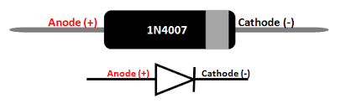
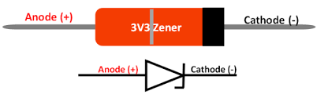
PN Junction Diode – 1N4007 - D1:
A diode is a device which allow current flow through only one direction.
For 1N4007 diode , the maximum current carrying capacity is 1A , it withstands peaks up to 30 A & power dissipation is 3W.
The reverse current is 5 micro A which is negligible.
Prevent reverse polarity problem ,used as protection device & used as current flow regulators.
3.3 V /0.5V Zener Diode - ZD1:
Nominal Zener voltage : 3.3V , Power dissipation : 500mW , Zener current : 76 mA , package : DO – 35.
Used in voltage protection circuits, used as low current voltage regulator & input voltage protection for microcontrollers or other IC’s

Slide 6
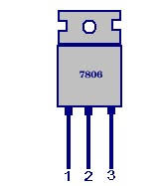
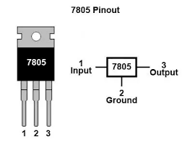
IC’s:
7806 REG. IC – IC1:
3 terminal 1 A positive voltage regulator
Features:
output current up to 1 A.
Thermal overload protection , short circuit protection & output transistor safe operating area protection.

Slide 7
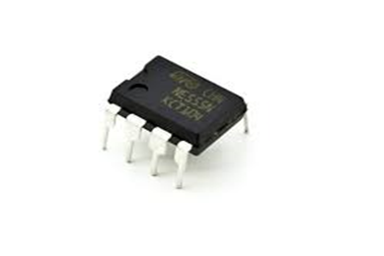
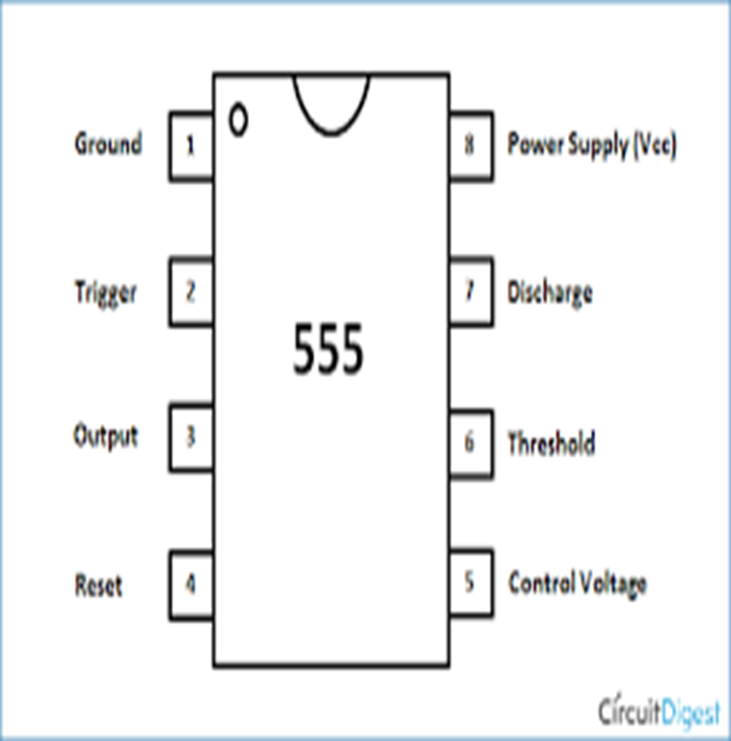
NE555 IC - IC2 & Pin Diagram:
555 Timer IC is an integrated circuit used in variety of time ,delay , pulse generation and oscillator application.
NE comes from sigNEtics , NE parts- commercial temperature – (0 to 70) degree C, SE parts – military temperature – (-55 to 125) degree C.
Standard 555 package includes 25 transistors, 2 diodes, 15 resistors in a Si chip with DIP-8 (8 pin dual in-line package)

Slide 8
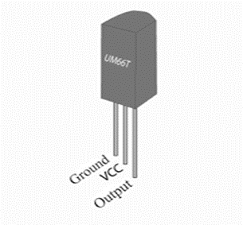
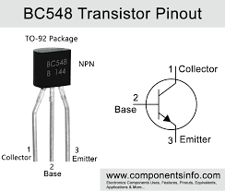
UM66 IC - IC3 :
It is melody generating IC used in calling bells.
It’s a 3 pin IC , first pin is ground , second pin is VCC and third pin is melody output.
supply voltage that can be given to the IC is in the range of 1.5V to 4.5V.
The melody generator has an inbuilt beat and tone generator .
Transistors – BC548 –T1,T2:
BC 548 is a general purpose NPN bipolar junction transistor, where B stands Si, C stands low frequency (100MHz).

Slide 9
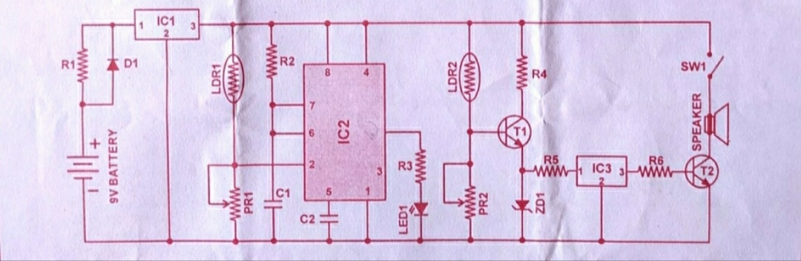
Circuit Diagram:

Slide 10
Product Description & Applications:
This circuit automatically turns on night lamp when bedroom light is switched off, the lamp remains ON until the light sensor(LDR!, LDR2) senses daylight in the morning, a super bright white LED (LED1) is used as the night lamp.
It gives bright & cool light in the room, when sensor(LDR1 , LDR2) detects the daylight in morning , a melodious morning alarm sounds.
The circuit is powered from a standard 9V battery , regulator IC7806 (IC1) gives regulated 6V DC to the circuit.
The circuit utilizes light dependent resistors for sensing darkness and light in room , the resistance of LDR is very high in darkness , which reduces to minimum when LDR is fully illuminated , LDR 1 detects darkness while LDR 2 detects light in the morning….

Slide 11
The circuit is designed around the popular timerIC NE555 (IC2)which is configured as monostable , IC 2(IC NE555) is activated by a low pulse applied to its trigger(pin 2 ), once triggered pin 3 of IC 2 (IC NE555) goes high and remains in that position until IC 2 is triggered again at its pin 2.
when LDR 1 is illuminated with ambient light in room, its resistance remains low, which keeps trigger (pin 2 ) of IC2 at a positive terminal .
As a result, output (pin 3 ) of IC2 (IC NE555) goes low and when the white LED remains off, as the illumination of LDR1 sensitive window reduces, the resistance of device increases.
In total darkness, the specified LDR has a resistance in excess of 280 kilo ohms , when the resistance of LDR1 increases, a short pulse is applied to trigger pin 2 of IC2 (IC NE555) via resistor R2 (120K ohm) ,this activates the monostable and its output goes high , causing the white LED to glow.

Slide 12
Low value capacitor C2(0.01 micro F) maintain the Monostable( output voltage becomes high for a set duration when a falling edge is detected on pin2) for continuous operation ,eliminating the timer effect, by increasing the value of C2, the ON time of LED can be adjusted to predetermined time.
LDR 2 and associated components generate the morning alarm at dawn, LDR 2 detects the ambient light in room at sunrise and its resistance gradually falls and T1 (BC548) starts conducting.
When IC1 ( 7806 REG.IC) conducts, melody generator IC3 ( IC UM66) gets supply voltage from emitter of T1 (BC548) and it starts producing conducting.
The musical tone generated by IC UM66 is amplified by T2, resistor R5 limits the current to IC3 and Zener diode limit the voltage to a safer level of 3.3V.
Use reflective holder for LED to get a spotlight effect for reading , place LDR away from white LED , preferably on backside of case , to avoid unnecessary illumination.
The speaker should be small so as to make gadget compact!!...

Slide 13
Thank You !!....

